Slide 1

FYP Project Proposal
Laundry Service Center
Anas Hussain Khan - 2112176
Umair Solangi - 2112203

Slide 2

Introduction
Aims to revolutionize the way laundry services are accessed and managed.

Slide 3

Introduction
Centralized web application for services.

Slide 4

Objective
Developing a user-friendly platform that seamlessly connects buyers and sellers.
simplifying the process of accessing laundry services.
More than one choice to select Laundry Service Provider.

Slide 5

Problem Description
Traditional ways of getting laundry done are usually complicated and hard to manage.
Physical Visit towards Laundry Shop.
More than one choice to select Laundry Service Provider.

Slide 6

Methodology

Slide 7


Methodology
Development Framework:
Front-End: React.js
Dynamic and responsive web applications
Back-End: Node.js
Robust capabilities for server-side development

Slide 8
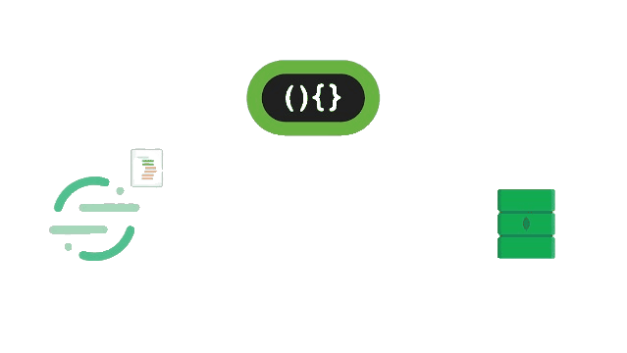
Methodology
Database Management:
Database: MongoDB:
Flexibility and scalability
Efficient data storage and management

Slide 9

Methodology
User Authentication:
Authentication Mechanism: JSON Web Tokens (JWT)
Secure user identity verification
Maintains session integrity

Slide 10

Methodology
Geolocation Integration:
API: Google Maps API:
Proximity-based service filtering.
Enhances user experience with location-based services.

Slide 11

Methodology
Agile Development:
Methodology: Agile:
Iterative development process
Continuous feedback incorporation
Adapts to changing requirements

Slide 12

Methodology
Testing and Quality Assurance:
Unit Testing: Jest
End-to-End Testing: Cypress
Ensures reliability and performance.
Identifies and addresses issues before deployment.

Slide 13

Project Scope

Slide 14

Project Scope
Excluded Aspects:
Hardware Development:
No design or development of physical hardware
Laundry machines
Delivery vehicles

Slide 15

Project Scope
Payment Processing:
No development of payment systems
No integration with financial institutions

Slide 16

Feasibility Study

Slide 17

Feasibility Study
Risks Involved:
Technical Challenges:
Integrating various APIs
Ensuring user data security
Market Risks:
Low adoption rates
Competition

Slide 18

Feasibility Study
Resource Requirements:
Computing Resources
Cloud-based servers (AWS, Google Cloud)
Development Tools
Software licenses: React.js, Node.js, MongoDB
APIs and Platforms
Geolocation APIs
Communication platforms (Twilio)

Slide 19
Solution Application Areas
Urban Residential Areas: Convenience and efficiency for residents
Hospitality Industry: Outsource laundry services for hotels and guesthouses
Corporate Offices: Employee perk to enhance satisfaction
Student Accommodations: Affordable services for students

Slide 20
Tools/Technology
Backend Development: Node.js
Database Management: MongoDB
User Authentication: JSON Web Tokens (JWT)
Geolocation Integration: Google Maps API
Communication Channels: Twilio, Email services
Hosting: AWS or Google Cloud

Slide 21
Expertise of Team Members
Frontend Developer: Skilled in React.js
Backend Developer: Proficient in Node.js and MongoDB
Full Stack Developer: Integrates frontend and backend
Project Management: Experienced in agile methodologies
Combined Experience: Courses in web development, database management, software engineering

Slide 22
Project Milestones
Month 1: Research and Requirements Gathering
Understand market needs and gather user requirements.
Month 2: System Design and Planning
Design system architecture, create wireframes, plan database schema and
API endpoints.
Months 3-5: Frontend and Backend Development
Develop frontend and backend components, implement authentication.
Month 4: Database Integration
Set up and integrate MongoDB.

Slide 23
Project Milestones
Month 5: Communication Channels Setup
Integrate Twilio for SMS, set up email services.
Months 6-7: Testing and Quality Assurance
Identify and fix bugs, ensure stability.
Months 8-9: Deployment and User Training
Deploy application, provide user training.
Months 10-12: User Feedback and Iterative Improvement
Collect feedback, implement improvements, ongoing testing.

Slide 24
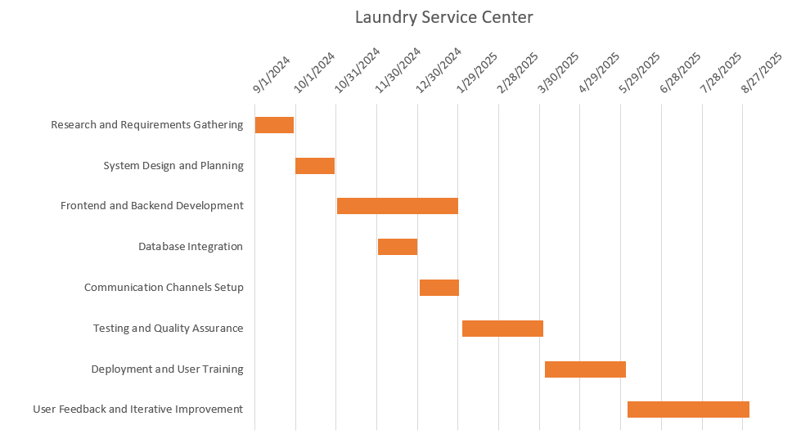
Project Schedule

Slide 25
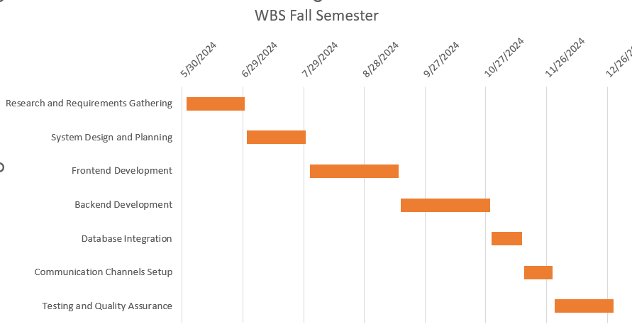
Work Breakdown Structure

Slide 26
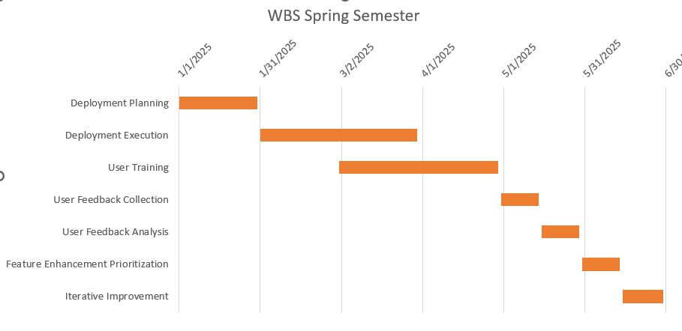
Work Breakdown Structure

Slide 27
References
1. React.js Documentation: Detailed documentation on the React.js framework, which is used for front-end development. Available at: [React.js Official Documentation](https://reactjs.org/docs/getting-started.html).
2. Node.js Documentation: Comprehensive guide and reference material for using Node.js, our chosen back-end development framework. Available at: [Node.js Official Documentation](https://nodejs.org/en/docs/).
3. MongoDB Documentation: Information on using MongoDB for database management. Available at: [MongoDB Official Documentation](https://docs.mongodb.com/).
4. JWT (JSON Web Tokens) Introduction: An overview of JWT for user authentication and session management. Available at: [JWT.io Introduction](https://jwt.io/introduction/).
5. Google Maps API Documentation: Resources and guides for integrating geolocation services via the Google Maps API. Available at: [Google Maps Platform Documentation](https://developers.google.com/maps/documentation).
6. Twilio Documentation: Guides and API reference for Twilio, used for integrating SMS and communication services. Available at: [Twilio Documentation](https://www.twilio.com/docs).
7. Agile Methodology Overview: Understanding the principles and practices of agile methodologies. Available at: [Agile Alliance Resources](https://www.agilealliance.org/agile101/).
8. AWS Documentation: Information on using Amazon Web Services for cloud hosting. Available at: [AWS Documentation](https://aws.amazon.com/documentation/).

Slide 28
Thank You

